Slide 1
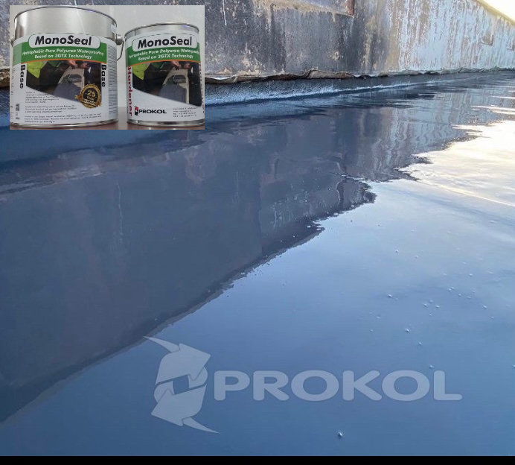
Pure Polyurea Waterproofing Membrane
Features
• Broof (T4) certified
• 1500% Elongation for Constant Thermal & Joint Movement
• 25 Year Single Point Manufacturer Warranty • Operational Temperature +110°C to -40°C
• Fully Moisture Tolerant
• Fully Hydrophobic
• Chemically Resistant • Smooth Finish
• Easy to Apply
• No Reinforcement Layer
• Direct to Substrate Application
• 1 Hour Cure – Foot Traffic 3 – 4 Hour

Slide 2
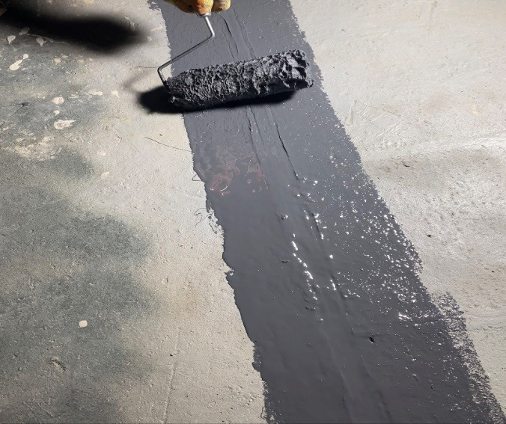
Application information Method
Trowel, squeegee, roller or brush
Usage 1,5 – 2,5 kg/m²/layer
Surface dependent
Mixing ratio 610 gram A : 390 gram B
Prolife** Approx. 35 minutes
Processing temp. Object -10 and +50 ºC
Product +15 and +25 ºC
Curing* After 1 hour
Workable* Between 2 and 4 hours Recoat time* Between 12 and 48 hours Chemical resistant* After 7 x 24 hours
Mechanical resistant* After 3 x 24hours Water resistant* Directly after application
Mixing instructions:
2-component products must always be mechanically mixed, preferably with a continuously adjustable mixing machine/drill (300 – 400 RPM) or another suitable mixer/whisk. As a guideline, the diameter of the mixer/whisk must be at least 1/3 of the diameter of the container in which the product is mixed in.
First mix component A until it is a homogenous mixture. Add component B (completely drained or scraped) to component A and mix at least 2-3 minutes until it is a homogenous mixture. To exclude unmixed materials (bottom/sides) are processed, transfer the mixture to a clean mixing bucket/tub and mix again.

Slide 3
Maintenance
Annual roof maintenance inspection
The following measures should be carried out to maintain the roofs performance:
● damaged roof frame and structural elements should be replaced.
● Loose fasteners should be tightened or if not possible additional fasteners added.
● Small holes in the sheets can be plugged with PU, or covered with a
PU flashing tape OR locally available alternate solutions.
● Torn or cracked rubber washers or sealing washers should be replaced to avoid leakage.
LIMITED WARRANTYS
1- 20 YEARS ON MONOSEAL PRODUCT
2-10 YEARS ON TOP COAT PRODUCT
3-10 YEARS ON PRIMER
WE Provides a limited warranty (10-20) years product and Installation on all products manufactured or private-labeled by the company. Limited Warranty states that the company warrants the product against defects in material or workmanship for 10-20 years from the date of installation. If a product malfunctions during the warranty period, the company is responsible for costs associated with repairing or Replacement of the product and installation only. all and repairs and installation must be done for the product by company employees WE will not be accountable or responsible for the original Owner and to any subsequent Owners or any construction company or any company or entity working on their behalf or the owners.. of any of the products Manufactured or private-labeled by the company are damaged as the direct result of deliberate or negligent or omissions including physical damage or work by the owner or any other either during or after installation. Any other sources of damage, such as natural disasters, fires, floods, electrical, lightning bolt, cracks, tornadoes, earthquakes, foundations settlement, cracks, owner hidden defects in floors, ceiling, walls, nonpayment, etc. if they Expose to its damage all of these above reasons lead to promptly canceling all Warranties. The client will perform all tests at his expense.
.

